Slide 1
Patient #2
Wilson Erwin

Slide 2
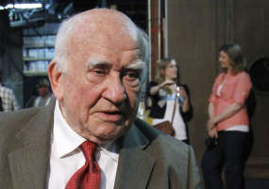
Meet Mark
Mark is a 78 year old man who was a very successful mathematician who had a great relationship with his family and loved playing card games with his daughter.

Slide 3
Mark’s Symptoms
Mark has recently been confusing the names of his relatives and has had some trouble controlling his emotions.
He now has trouble doing simple calculations, loses things frequently, and has trouble remembering the card game he plays with his daughter.

Slide 4
Diagnoses
Mark has Alzheimer’s based on his symptoms which correspond with most Alzheimer’s patients.
Alzheimer’s is a degenerative disease in which the brain deteriorates and people loose certain bodily functions.
Symptoms:
Difficulty speaking
Trouble with memory
Cognitive skills

Slide 5
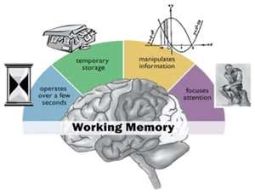
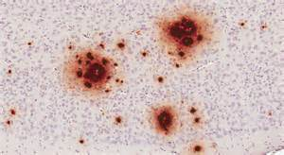
How Does This Affect the Brain?
Alzheimer’s disease begins with the breakdown of cells in the memory center of the brain.
Also characterized by the formation of clumps in the brain called amyloid plaques.
Also tangled nerve fibers called neurofibrillary tangles occur.

Slide 6
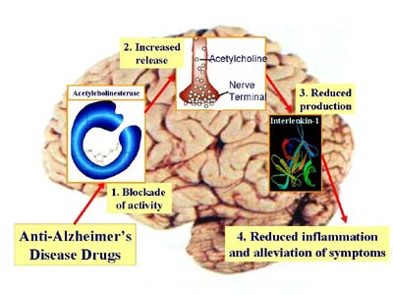
Prognosis
Alzheimer’s disease does not have a cure.
Doctors prescribe drugs to help slow the effects of Alzheimer's, however most of the drugs have little to no affect.

Slide 7
People to Help…
Neurologist- Neurologist can help diagnose this disease and have the ability to prescribe medicines to help slow the process.
Nurses- They help take care of patients who have Alzheimer’s disease and often care for them as the disease progresses.
Therapists- Therapists may also help the family who’s family member is being affected by the disease.

Slide 8
Why Does This Occur?
http://www.ncbi.nlm.nih.gov/pubmedhealth/PMH0001767/
http://www.ehow.com/how-does_4599929_alzheimers-affect-brain.html

