Slide 1
Cystic Fibrosis- Case #555555S The A. Smith Family
Thad Estes

Slide 2
About the Disease
A hereditary disorder.
Affects the exocrine glands.
Causes production of thick mucus that blocks pancreatic ducts, intestines, and bronchi.
Results in a respiratory infection.

Slide 3
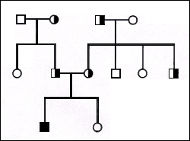
Punnett Square & Pedigree
Cystic Fibrosis is an autosomal recessive disease.
If only one parent is a carrier, there is a 0% chance of the child having Cystic Fibrosis.
If both parents are carriers, there is a 25% chance of the child having Cystic Fibrosis.
If neither parents are Carriers, then it is a 0% chance of the child having Cystic Fibrosis.

Slide 4
3 Frequently Asked Questions
How early can Cystic Fibrosis be diagnosed?
It is diagnosed during infancy.
Is physical exercise capable for someone with Cystic Fibrosis?
It is very possible and it actually helps clear mucus from organs and lungs.
What is the life expectancy of someone with Cystic Fibrosis?
The life expectancy is between 35 and 40 years.

Slide 5
Case Recommendation
I would recommend that Aaron and Gina need to have a genetic test, such as carrier screening performed. This will help clear up all concerns that they may have. If one of them are, in fact carriers, then we will have a meeting regarding the situation when the time comes. If not, then they are all clear to start their new family.

