Slide 1
WITH Biometrics Inc.
Providing thorough protection for our clients and their associates.

Slide 2
Overview
Eye scanners will be at the boarding gates and will act similarly to boarding passes. Everyone who will be boarding the flight will have to undergo an eye scan in order to confirm their identity matches who they say they are.
Facial recognition software will be installed into all of the cameras in the airport. The cameras will look for suspicious activities and will compare their faces to a database. This will help the airports to catch potential suspects who may be terrorists or criminals.
Also random DNA checks will be issued along with the random bag checks. Since random bag checks are done on people who may be potentially dangerous, this will further help confirm the identity of the person.
Fingerprint scanners will be used to control the entrance into restricted areas. The scanners will prevent people from entering the wrong areas. Also, fingerprint scanners will be used in place of eye scanners if someone cannot undergo that test.

Slide 3
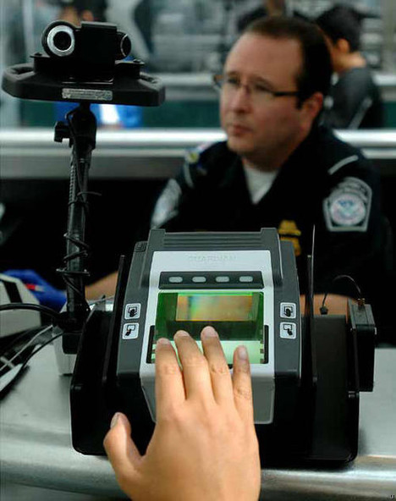
Fingerprint Scanners
Fingerprints: The way a fingerprint scanner is used is by scanning an image of the ridges and furrows of the fingerprint and then compares it if they are in the correct place where ridges end or fork with those in the file. The fingerprint scanner is 95-98 percent accurate. The way it can be beaten is by creating a fake fingerprint.

Slide 4
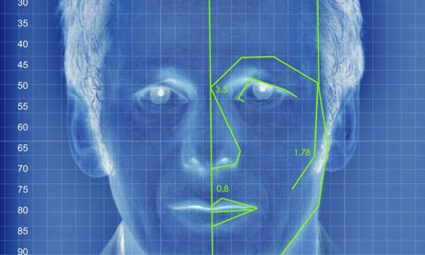
Facial Recognition
Face: The facial recognition is performed by capturing an image with a camera of the face then analyzing for certain “nodal places” like the distance between the eyes to the other and the width of the nose. Then a unique template is generated based on nodal points then comparing it against other templates. The facial recognition is about 80-90 percent accurate. The way the facial recognition can be defeated is by holding up a photograph of the person in front of the camera and/or it can affect it if you gain or lose weigh on the face.

Slide 5
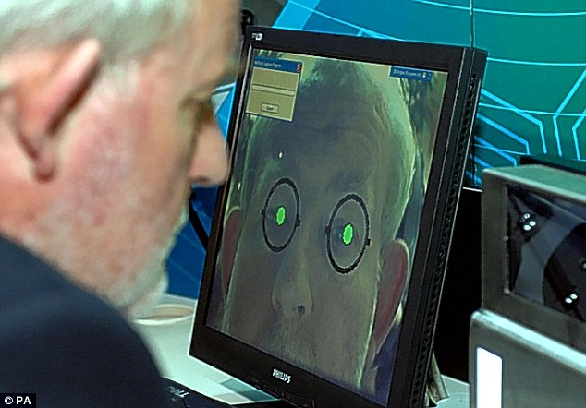
Eye Scanner
Eyes: There are two different types of scans one is Retinal scan and the other is Iris scan. The Retinal Scan measures the pattern of blood vessels in the back of the eye. The Iris scan is performed by using a video camera examining the unique patterns of ridges on the color portion of the eye. Is the most accurate biometric, but sometimes won’t work in some cases. The way Retinal scan can be defeated is by wearing color contacts or the use of drugs that can dialect your pupil. The way the Iris scan can be defeated is by holding up a picture of the eye and cutting a hole to reveal the fake person pupil.

Slide 6
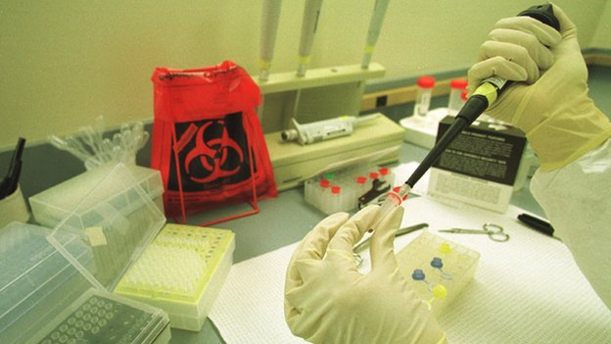
DNA Testing
DNA: The way DNA biometrics work is by obtaining blood, saliva, hair, skin then it generates the DNA and matches it with the correct person. The accuracy of the DNA is if two people have the same DNA and that’s about 6 billion to 1 or unless they are identical twins. It’s really hard to beat the DNA of a person, they say unless they obtain the DNA of someone by a strand of hair or by obtaining a person’s DNA profile, but there is not really a way DNA can be beaten.

Slide 7
Success Story
Once upon a time, there were these Arabian people in the waiting area, where you wait to board a flight. They had passed through security by altering their fingerprints. They altered them by cutting off the top part of skin on someone else’s finger and gluing it to their fingers. The facial recognition software cued the security guards that roam the airport that they looked suspicious. They handcuffed the Arabians and brought them to a secure location. Once there, the security guards performed DNA tests and found out that the Arabians were fraud. Once searching the accused “terrorists,” the security guards found that they had no boarding passes. Then, there were these really pale Arabians and they were at the eye scanner, which you have to pass through to board the plane. They had the same tickets which were purchased by the “accused terrorists.” Once searching them we found supplies for a highly explosive bombs. By having our software and intellectual security guards, we saved a plane from getting bombed.

Slide 8
Privacy Concerns
Although some people may have issues with their personal information, i.e. fingerprints, DNA, etc. being circulated around, it is necessary to have this information at an airport to protect travelers from potential danger.

